Slide 1


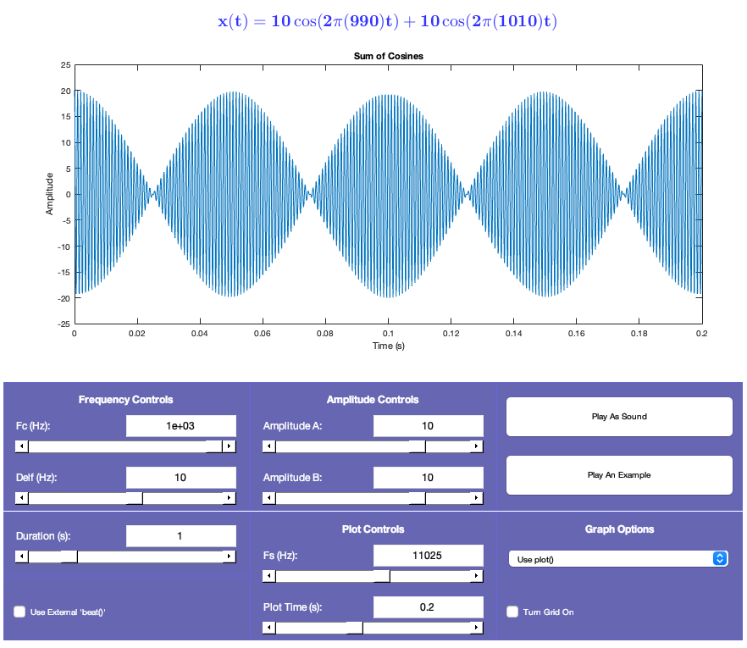

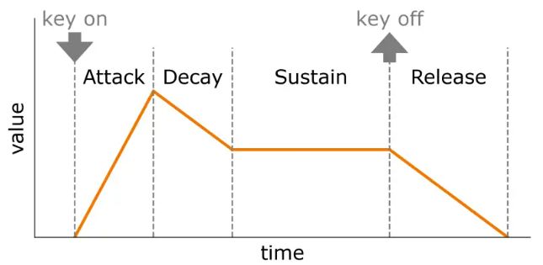

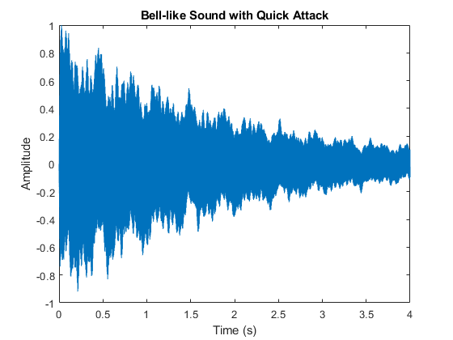
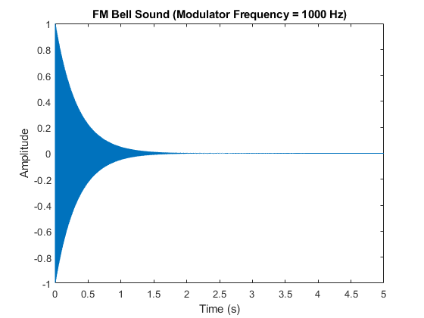

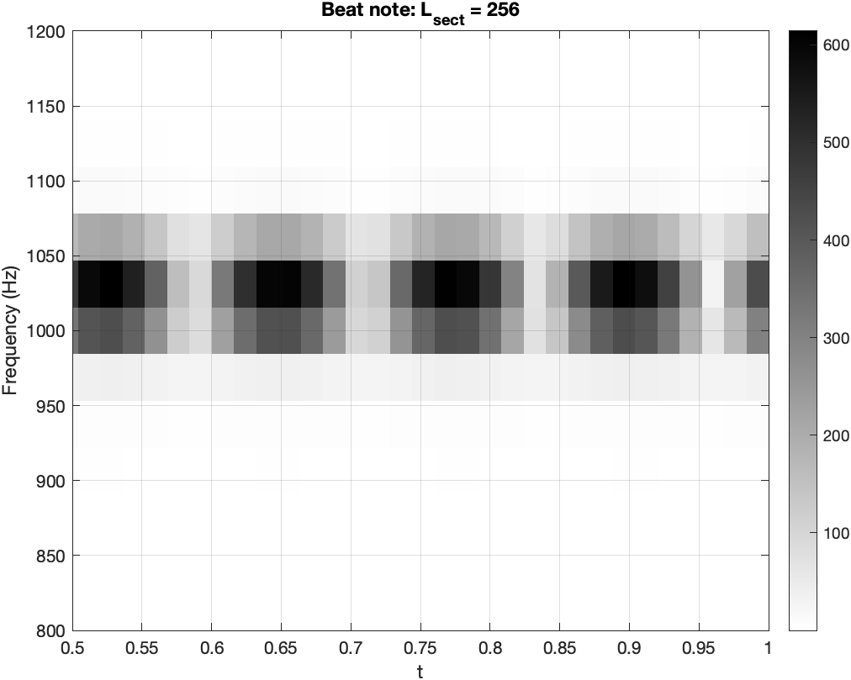
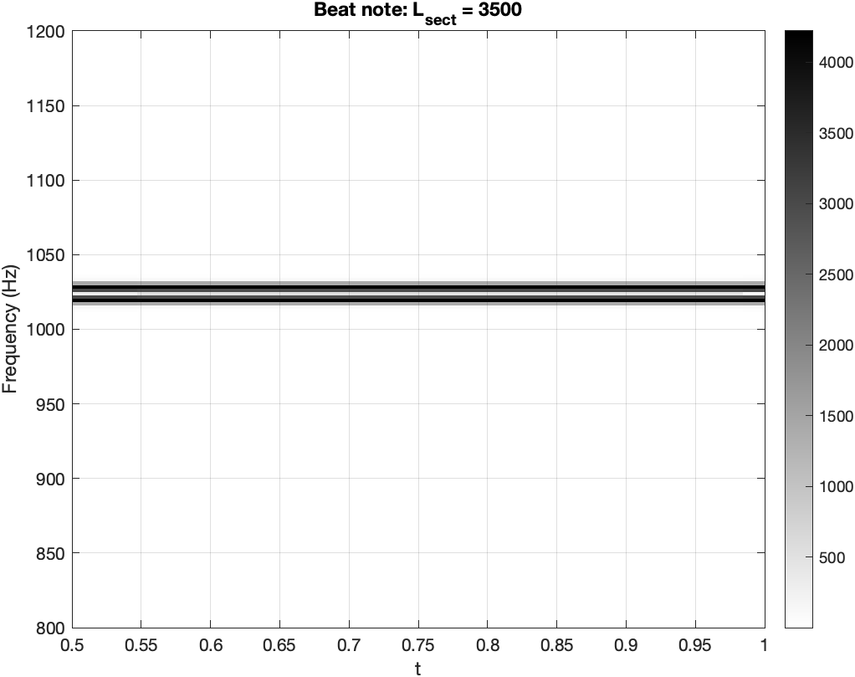
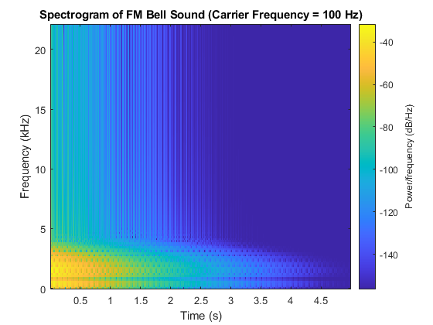
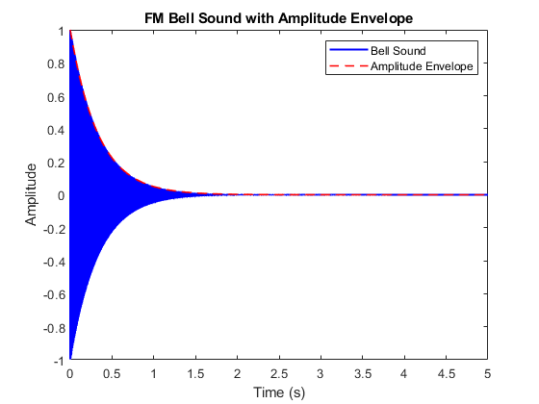
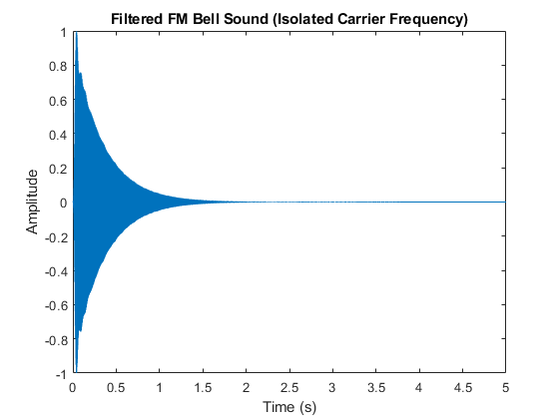
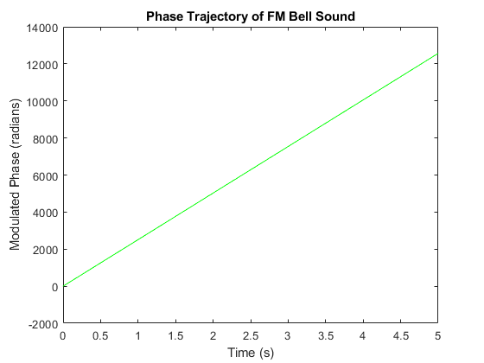
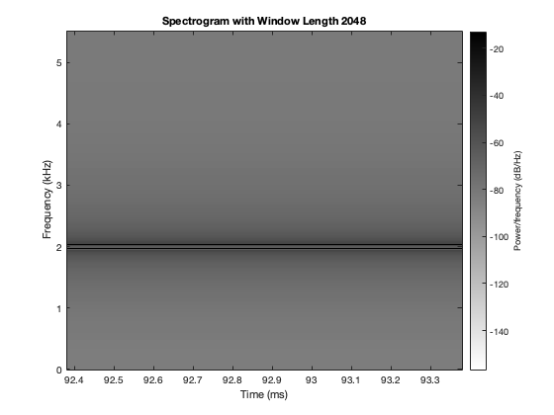
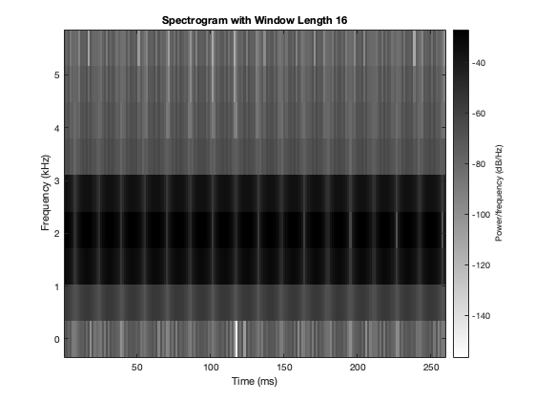


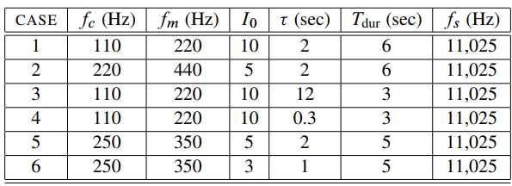
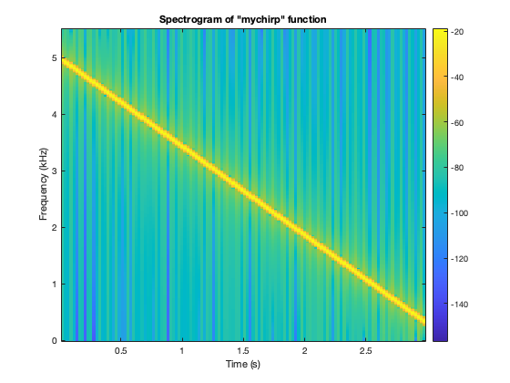
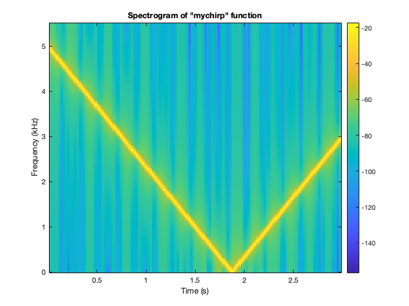
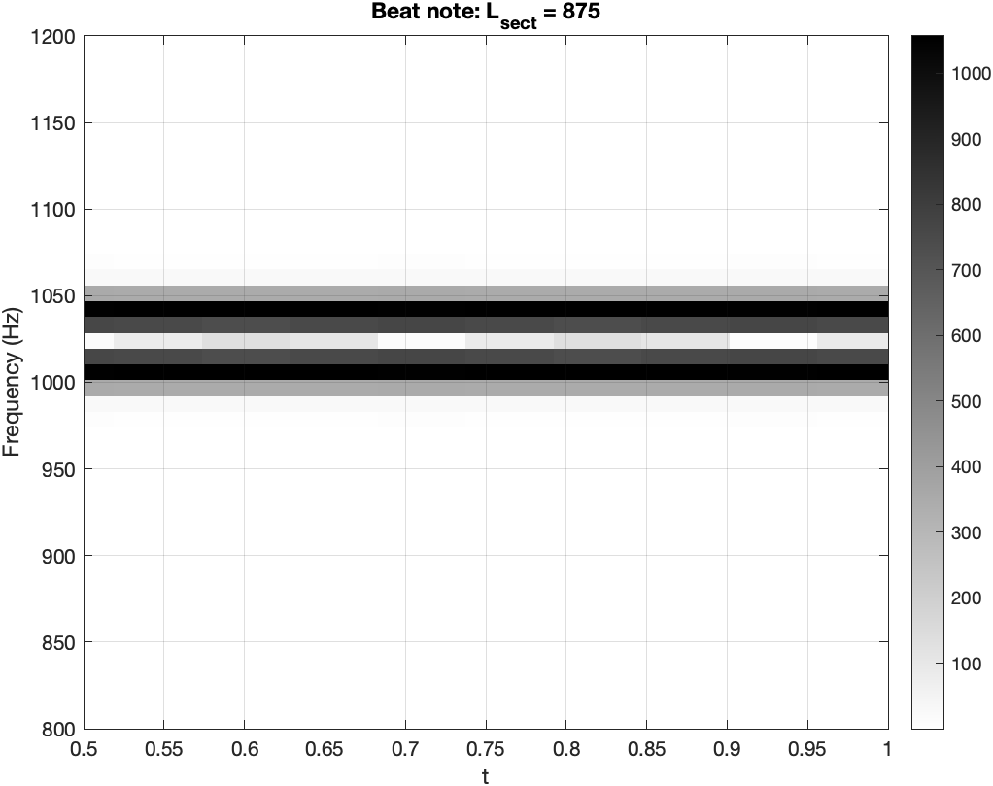
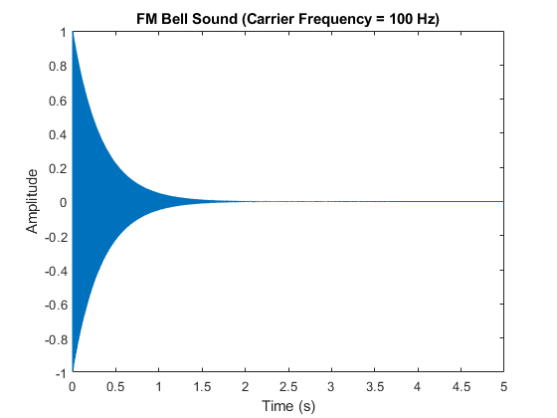
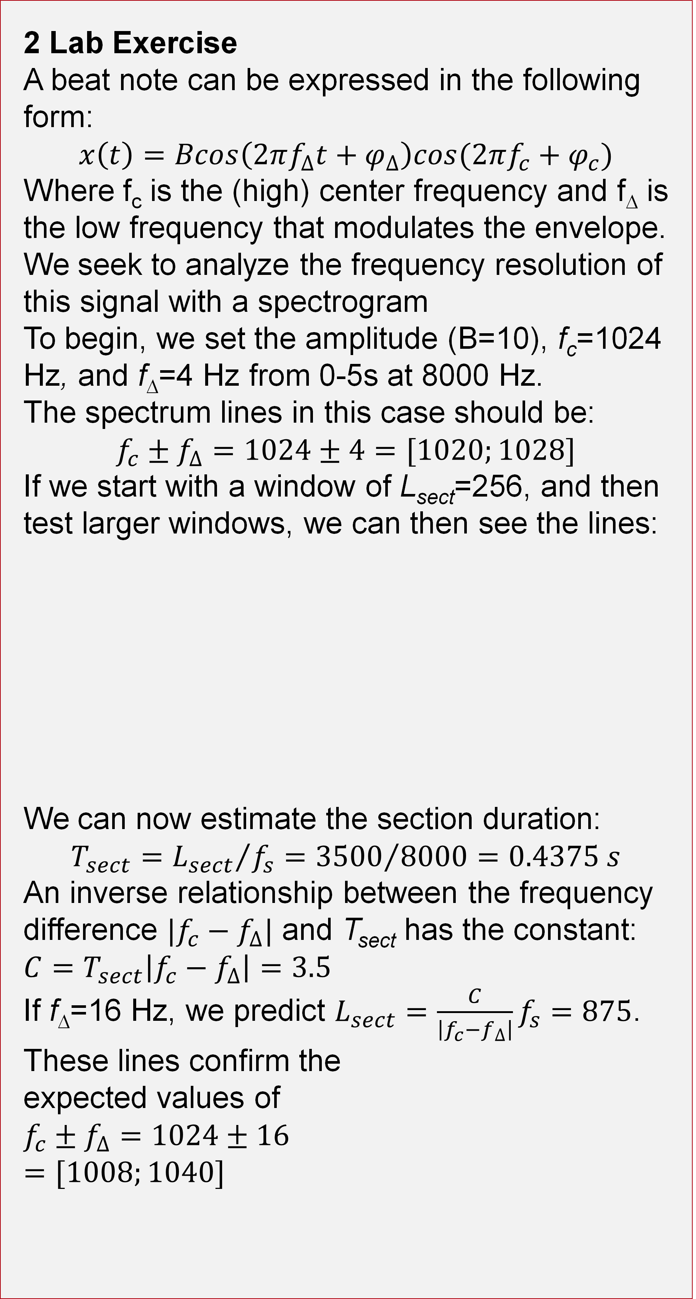
Spectrum Representation
AM and FM signals, synthesis for musical instruments
Isaac Vaughan, Jaron Tsao, Mohamad Hajj, Merrill Datwyler – Department of Electrical and Computer Engineering - University of Utah
P-4: AM and FM Sinusoidal Signals
P-7: FM Synthesis for Musical Instruments
S-7: Spectrograms of AM and FM Signals
Signal Interaction and Analysis
This lab explores key signal processing concepts, including beat frequencies, spectrogram analysis, and chirp signals, to understand how signal parameters like frequency and time resolution influence data.
4 FM Synthesis of Instrument Sounds
4.1 Generating the Bell Envelopes
4.2 Parameters for the Bell
4.3 The Bell Sound
4.4 Comments about the Bell
2 Lab Exercise
A beat note can be expressed in the following form:
$$x\left(t\right)=Bcos\left(2πf_{∆}t+φ_{∆}\right)cos(2πf_{c}+φ_{c})$$
Where f_{c} is the (high) center frequency and f∆ is the low frequency that modulates the envelope.
We seek to analyze the frequency resolution of this signal with a spectrogram
To begin, we set the amplitude (B=10), f_{c}=1024 Hz, and f∆=4 Hz from 0-5s at 8000 Hz.
The spectrum lines in this case should be:
$$f_{c}±f_{∆}=1024±4=[1020;1028]$$
If we start with a window of L_{sect}=256, and then test larger windows, we can then see the lines:
We can now estimate the section duration:
$T_{sect}={L_{sect}}/{f_{s}}={3500}/{8000}=0.4375 s$
An inverse relationship between the frequency difference $|f_{c}−f_{∆}|$ and T_{sect} has the constant: $C=T_{sect}\left|f_{c}−f_{∆}\right|=3.5$
If f∆=16 Hz, we predict $L_{sect}=\frac{C}{\left|f_{c}−f_{∆}\right|}f_{s}=875$.
These lines confirm the
expected values of
$$f_{c}±f_{∆}=1024±16$$
$$=[1008;1040]$$
Chowning found he likes a fundamental frequency of 40 Hz and carrier to modulation frequency ratio of 5:7.
1Ref: John M. Chowning, “The Synthesis of Complex Audio Spectra by means of Frequency Modulation,” Journal of the Audio Engineering Society, vol. 21, no. 7, Sept. 1973, pp. 526–534 https://thewolfsound.com/envelopes/
Notes:
6

